Slide 1

SUPERSTORE ANALYSIS

Slide 2
Overview
Superstore dataset was gotten Kaggle website which represents the sales of various products under the category of furniture, office supplies and technology. The dataset shows the subcategories, shipping details across various locations and performance trends, it clearly provides business insights on sales generated, profit made and discount given across all products. The primary objective of the dataset is to analyze and extract strategic information on products that needs to given proper market campaigns, products in which the company making loss. The analysis will help stakeholders identify trends at a glance instead of looking at rows of raw data.

Slide 3
Business Problem
Which region generates the most profit?
Which productions are underperforming?
The states that generated the most revenue
What is the total revenue generated, profit made, discount given
Sales trend by month and weekday
Day difference between ship date and order date, to identify products with same day delivery and the days it took for products to be delivered
Sales/ profit generated by segment, category and subcategory

Slide 4
KPI METRICS
Total sales / revenue Revenue generated from all transactions
Profit margin Profit percentage
Price per unit Average price per product unit
Total quantity Total units sold
Total discount The sum of discount given
Total profit Total earnings after cost removal

Slide 5
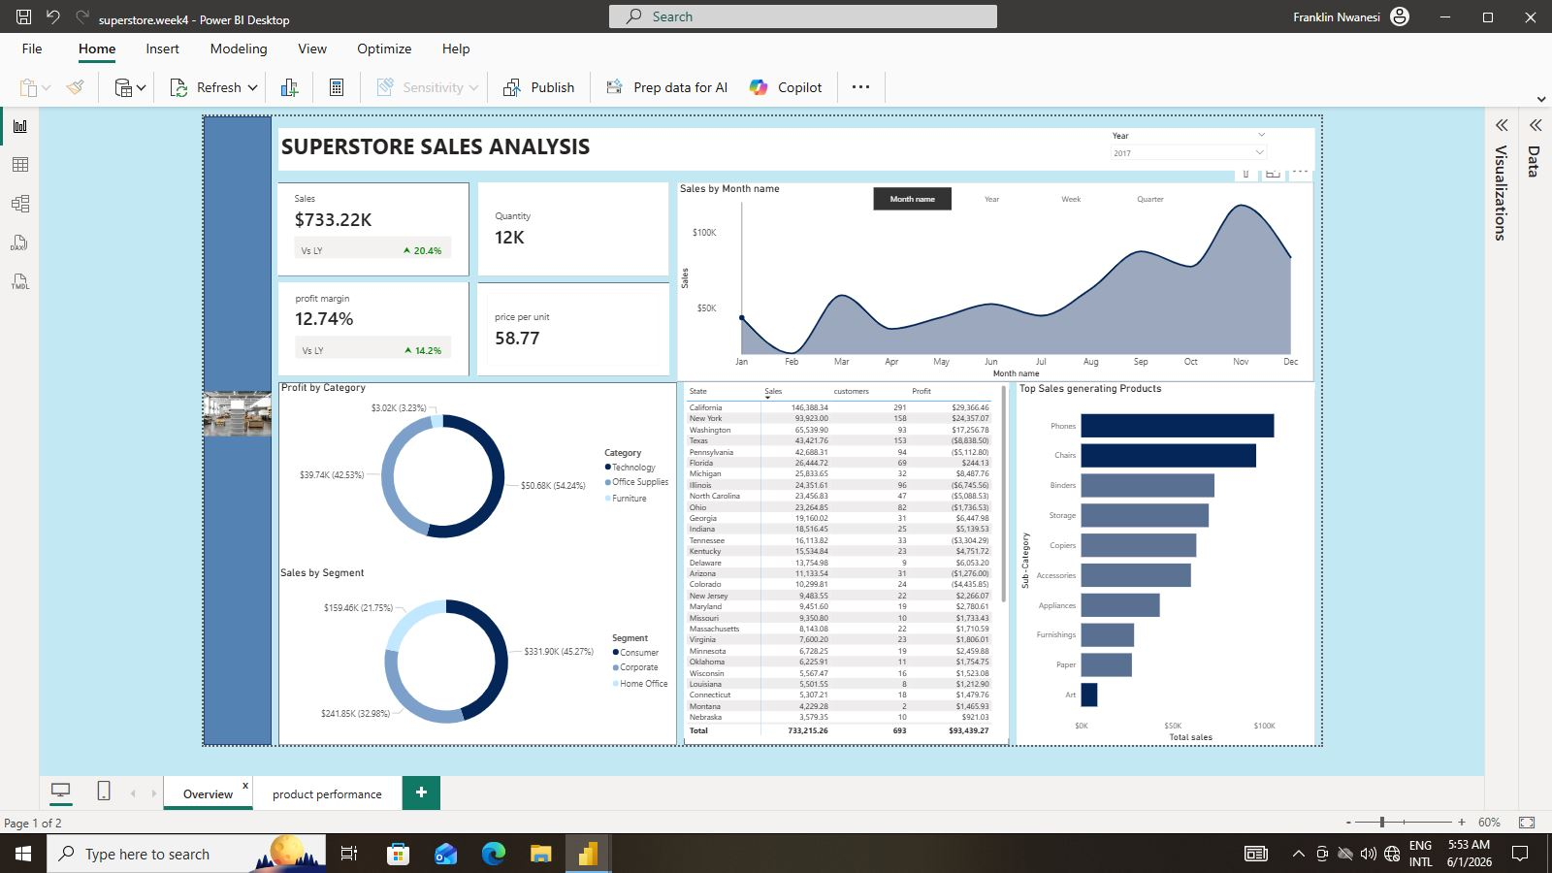

Slide 6
Key insights
Trend Analysis
Sales dropped drastically on Wednesday
Sales trended up from 2014 to 2017 with peak performance in 2017
Sales significantly increased in the 4th quarter and peaked in the month of November.
Discounts above 6% resulted in loss subsequently
Phones and chairs generated the most sales
The most profit was generated in the western region and the only region where the profit is more than the discount given. Other regions have their profits less the discount given ranging from 3% to 97% increase
Majority of products are shipped through standard class and it takes averagely 4 days to get products shipped

Slide 7
Recommendations
Launch marketing campaigns or outreach across locations on Wednesdays to improve sales on this weekday
Reduce discounts on low profit products
Each region should review discounts the given to make sure there is a scalable balance that makes profit outweigh discounts
Products that are underperforming should reviewed for marketing or discontinuation
Keep the promotion of phones and chairs up and double down on the remaining products to avoid fully relying on just phones and chairs
Increase investment on technology and office supplies

Slide 8
CONCLUSION
The analysis showed that high sales does not equate profitability as seen in the furniture category which made $742,000 but a profit margin of 2.49% compared to other categories with over 17% profit margin each.
Findings
Certain regions need to review their discount strategy for profit improvement
Technology products drive the most profit
High discounts affected profit margin negatively

